Slide 1
Data Science
Challenge
Edwin

Slide 2
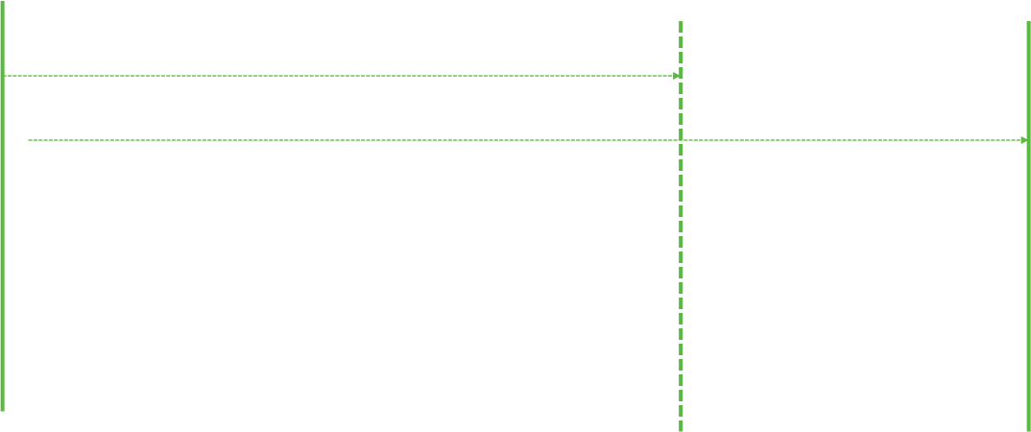




Sequence of events for a shopper hiring process
Question: What if initiating background check earlier
apply
Attribution window
mail card
activate card
initiate background check
complete background check
take orientation
complete first batch
application window
a/b test window

Slide 3
Q1: Evaluate A/B test result
If initiating background check earlier …
❶ Increases first batch completion rate
❷ Reduces the entire hiri ng process time (processes optimization)
❸ Evidence does not show shoppers will start quickly if they complete card activation and background check (we can not include the duration of background check into shopper momentum calculation, because it is a passive waiting)
group | #applicant (sample size) | #completed first batch | ❶ conversion rate | ❷ #days from application to first batch completion | ❸ #days from both completion (card activation, background check) to first batch completion
control
treatment
10,024
4,958
2,678
2,115
26.7%
42.7%
10.2 days
7.1 days
1.95 days
2.00 days
accelerated the hiring process significantly
conversion rate
significantly i ncreased
(z score 19.2;
significant at 90%)
stimulate shopper to
start more quickly
insignificantly
conclusion
improve
improve
* Appendix: z test and sample size

Slide 4

Q2: Is this change cost-effective?
We are using card activation rate, and the average of first batch completion cost to evaluate cost-effective
Because the card activation event is the most close to the initialing background event in the hiring funnel, and the average cost per first batch completion is the most effective metric to evaluate dollar efficiency.
We could like to check whether the activation funnel is expanding, if initiating background check earlier.
Orientation event is one of factors might impact the conversion rate, so using bottom of funnel to evaluate is not an ideal metric.
A qualified potential shopper in hiring process must both activate card and pass background check, then enable them to become a “successful” shopper, so we would like to focus on card activation rate and dollar efficiency at the same time.
card activation rate
group | overall | job site search | shopper referral bonus | social media | web search engine | Dollar efficiency
control | 86% | 67% 96% 96% 83% |  |  |  | $96
treatment | 94% | 87% 97% 98% 94% |  |  |  | $70
z score At 90% | 17.1 significant | 12.35 significant | 0.54 insignificant | 3.4 significant | 13.3 significant
Background check initiation Background check initiation | Expand funnel from 86% -> 94%
card activation
Yes
fective
Yes
costef
t effective
cos

Slide 5
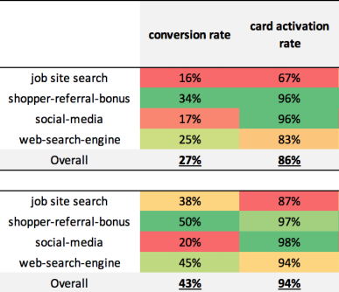
Q3: Observation
job site search channel:
• lowest conversion rate i n the cont rol group
• conversion rate significantly improved, if initiating background c heck
• orientation completion rate is the lowest i n the test
social media channel:
• generates ineffective leads i n the test
• conversion rate insignificantly improved, if initiating background c heck
• lowest orientation completion rate
shopper referral bonus channel:
• highest conversion rate i n the cont rol group;
• generates effective leads
• highest orientation rate
web search engine channel:
• lowest conversion rate i n the cont rol group;
• conversion rate significantly improved, if initiating background check
Control
Treatment

Slide 6

Q3: Recommendation
_{❶} To perform A/B Test to evaluate if mandatory orientation would
improve the conversion rate
❷ To perform A/B Test to evaluate if accelerate the duration of
background check would make shopper start to shop quickly
(control group) | successful hiring | Not successful hiring
orientation completed | 47% | 42%
no orientation | 53% | 58%
# _{Applicants} background check duration
4000
100%
100%
3500
3000
2500
2000
1500
1000
500
0
avg 4 max 12 min 2 25% 3 50% 4 75% 5 90% 6
^{❸} The conversion rate in social media channel is much lower than average
If this channel is paid advertising, we should evaluate the ROI, which cost is channel acquisition cost + $30 background fee, etc. to check if the social media channel is an effective way to attract potential shoppers
key metrics # days
group | social media conversion rate | overall
control | 17% | 27%
treatment | 20% | 43%
2 3 4 5 6 7 8 9 10 11 12
# Days
* Due to the sample size, this analysis does not break down into the city level

